Slide 1
Use an RNN to classify a sentence as Positive, Negative, or Neutral based on its final hidden state.
Deep Learning – Practical 10

Slide 2
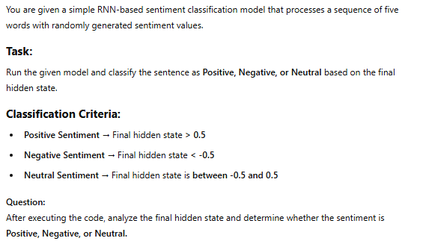

Slide 3




Slide 4
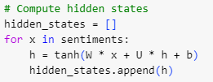




Slide 5
